Slide 1
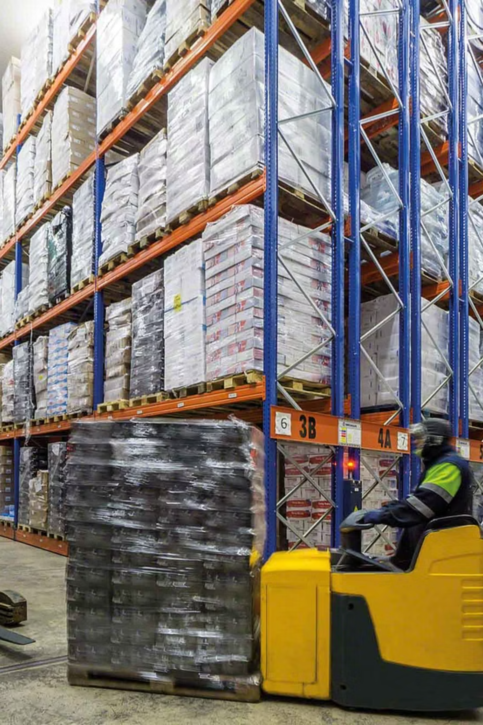
Cold Storage Monitoring (E2) Automated IoT Solution
Team OptiChainers :
Sneha Bhattacharyya
Madhumanti Mallick
Saudeep Chattopadhyay
Nikita Singh
Gargi Shubham
Ishita Majumdar
Ritika Garai

Slide 2







^{Our Team}
Sneha Bhattacharyya
Madhumanti Mallick
Saudeep Chattopadhyay
Nikita Singh
Gargi Shubham
Ishita Majumdar
Ritika Garai

Slide 3
The Cold Chain's Vulnerability: Why Manual Monitoring Fails
Manual Checks: A Flawed Approach
High Stakes: Risks & Consequences
Current cold storage relies on laborious manual temperature and humidity checks, introducing significant human error and inefficiency.
Food/product spoilage
Significant financial losses
Non-compliance with critical regulatory standards (USDA, FDA, EU)
This outdated approach creates a critical gap, exposing businesses to substantial risks and hindering operational excellence.

Slide 4




Our Solution:
Real-time Monitoring
Customizable web interfaces
Secure Authentication
Data Visualization & History

Slide 5
Why OptiChainers Stand Out: Our Unique Edge
1
Bespoke & Adaptive Solutions
2
Proactive Maintenance
Our system offers fully adaptable zones, sensor configurations, and thresholds to meet diverse client needs.
We go beyond reactive fixes, detecting and flagging failing sensors before they compromise data integrity.
3
Regulatory Compliance Ready
4
Seamless Integration
Built with USDA, FDA, and EU guidelines in mind, ensuring your operations meet stringent industry standards.
Alerts are integrated with existing systems, and data is pushed to customisable Power BI dashboards for deep insights.

Slide 6
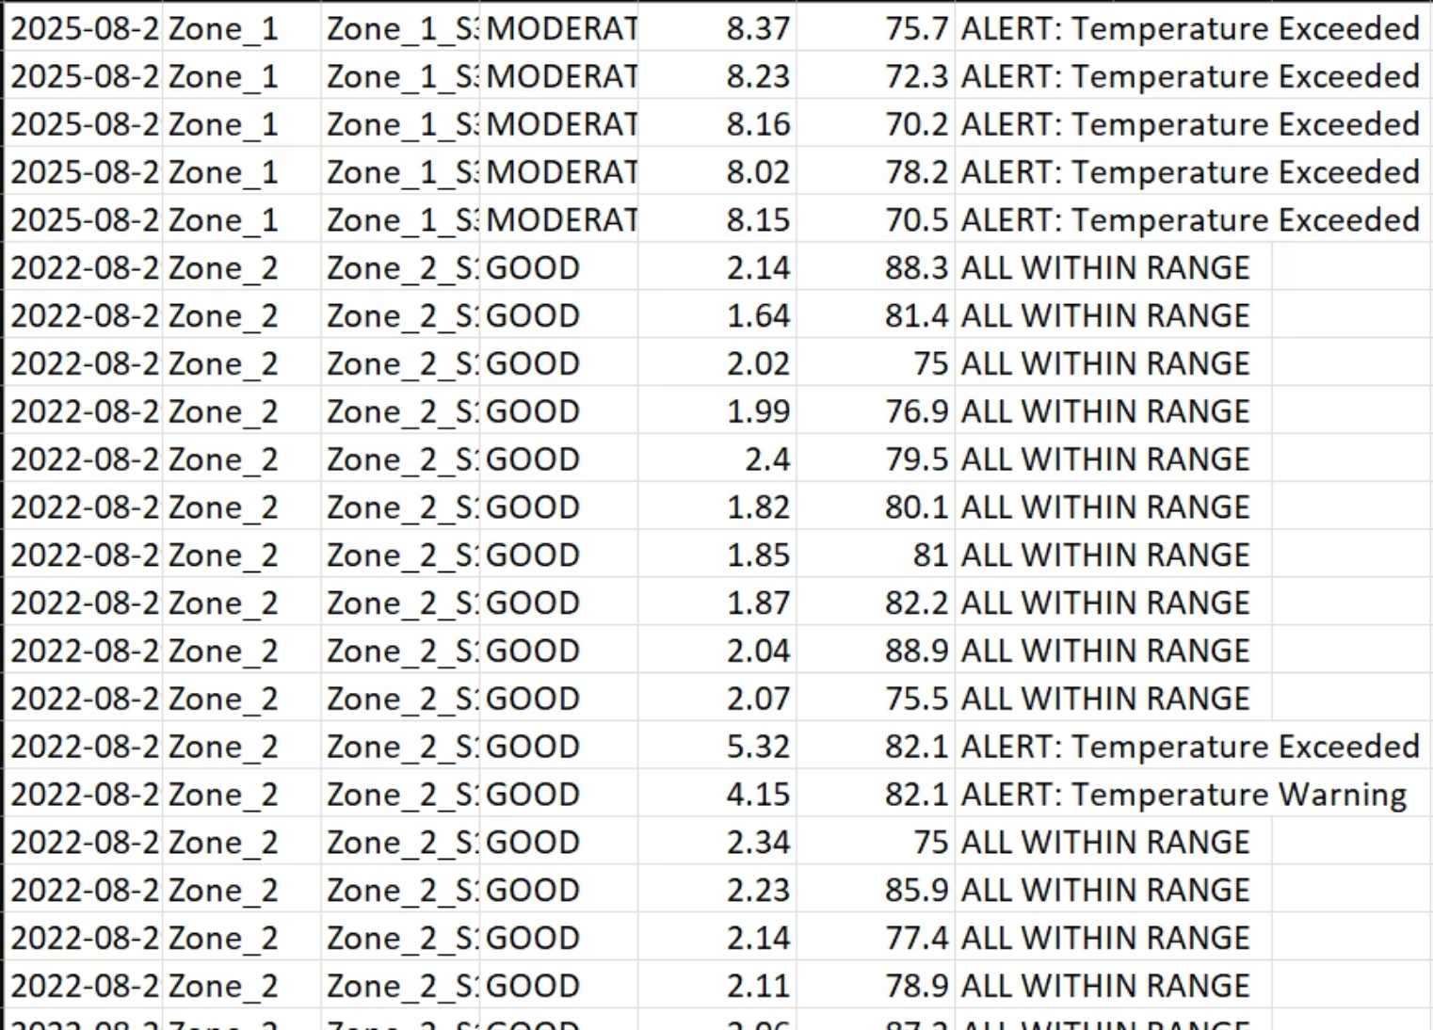
Robust Data Acquisition: Powering Our Analytics
This dataset includes all permutations of alerts, warnings, and simulated sensor failures, providing a realistic test environment.
3 years of historical data plus recent, live-simulated inputs.
Parameters considered for rich simulation:
Diverse Zones: multiple zones signifying storage of various edible and perishable goods
Multiple Sensors per zone: Each zone has 3 unique sensors.
Varied Sensor Profiles: Simulating GOOD, MODERATE, and FAILING states.

Slide 7
Data Structure: A Glimpse into Our Dataset
timestamp
2023-10-26 14:30:00
Date and time of reading
zone
Chilled
Storage area (e.g., Frozen, Ambient)
sensor_id
SENSOR001
Unique identifier for the sensor
temp °C
4.2
Temperature in degrees Celsius
humidity %
78.5
Relative humidity percentage
status
ALERT: Temp Exceeded
System-evaluated condition (e.g., OK, Warning, Alert)
sensor_profile
MODERATE
Sensor health assessment (GOOD, MODERATE, FAILING)
This structured data forms the backbone of our real-time monitoring and predictive analytics.

Slide 8
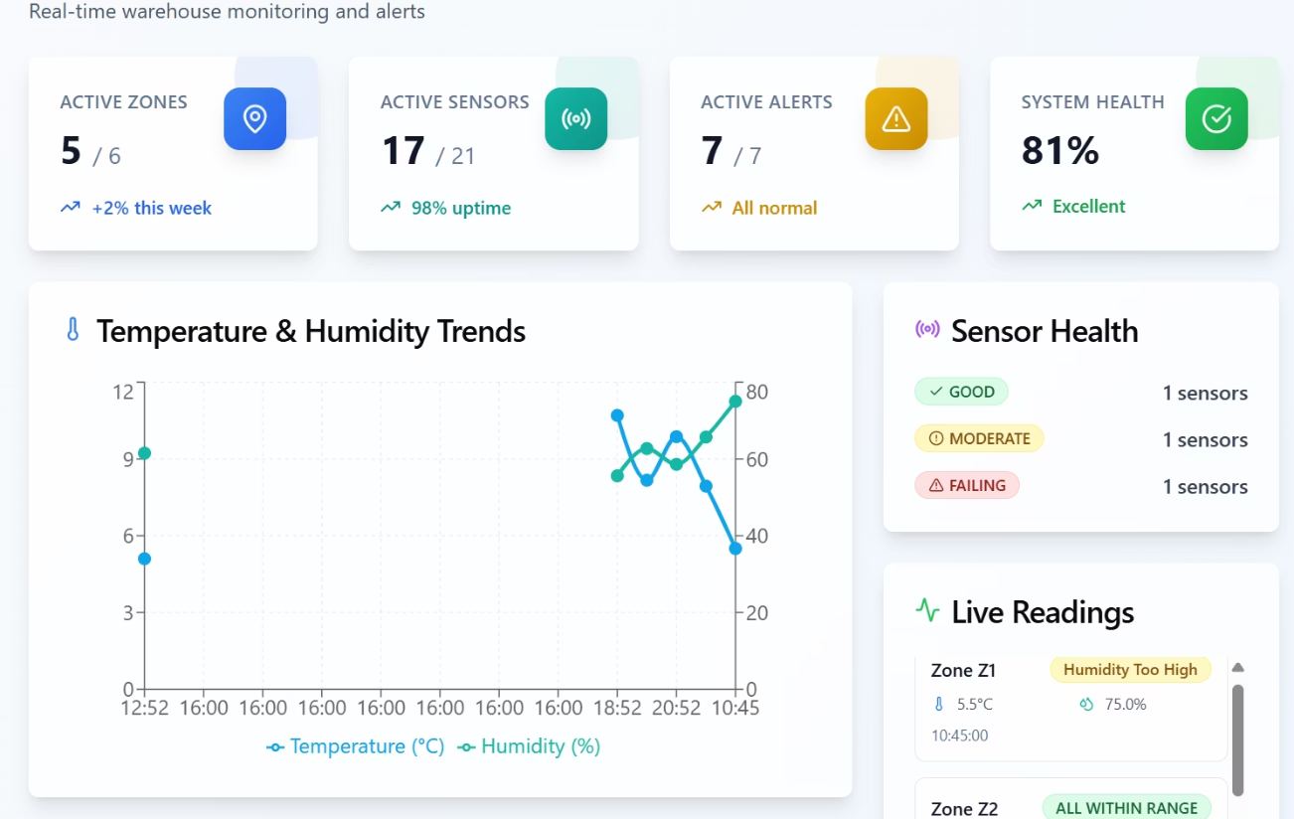
Web Interface: Interactive Data & Control
Experience Real-time Insights and Seamless Management
Our intuitive web interface provides a comprehensive view of your cold storage environment, transforming raw sensor data into actionable insights:
Real-time Data Visualization
Historical Trends & Analytics
Alert Management
User-Friendly Access
Live Interface Link: https://execution-app.vercel.app/

Slide 9
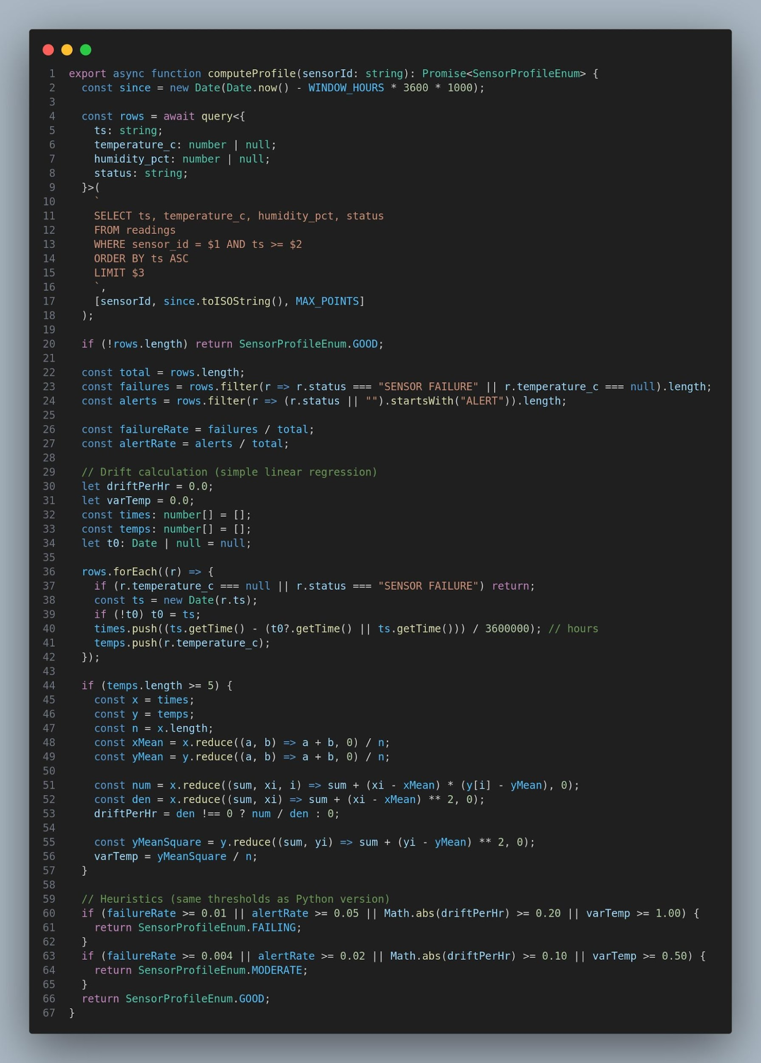
Core Logic: Snippets from Our Backend
Our robust backend is built on NextJS API Framework for efficient data ingestion and processing:
GitHub Repository Link: https://github.com/Sneha-Bhattacharyya/Execution_App

Slide 10
System Flow: From Data Capture to Insights
This clear, sequential flow ensures reliable data processing, immediate alerts, and comprehensive historical records.

Slide 11
IoT-Enabled Cold Storage Solution
Real-time Monitoring: Sensors track temperature, humidity & airflow continuously.
Instant Alerts: Threshold breaches trigger buzzer + dashboard notifications.
Data Insights: Historical logs & KPIs for compliance and efficiency.
Resilient System: Works even during internet downtime with auto-sync.
Business Impact: Reduces spoilage, ensures freshness & regulatory compliance.

Slide 12
Intelligent API: Evaluation Logic Explained
1
2
3
Threshold Comparison
Granular Status Categories
Predictive Sensor Profiles
Readings are immediately compared against dynamic, zone-specific thresholds with an added tolerance.
ALL WITHIN RANGE
Sensors are classified into dynamic profiles: GOOD, MODERATE, or FAILING, enabling proactive maintenance.
ALERT: Temperature/Humidity Warning/Exceeded
SENSOR FAILURE
Our logic ensures quick identification of environmental deviations and predictive insights into sensor health.

Slide 13
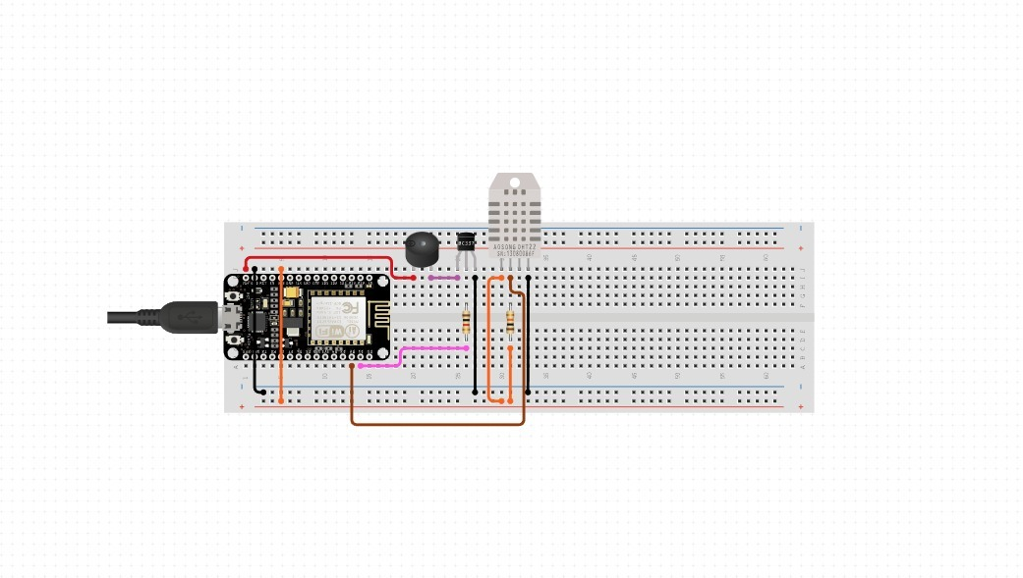
Circuit Diagram
Components
Breadboard Diagram Components
Our robust cold storage monitoring solution relies on precise hardware integration, ensuring accurate data capture and immediate alerts.
This diagram illustrates the physical wiring for our sensor unit,
connecting the ESP8266 microcontroller to the
DHT11 sensor and the buzzer.
ESP8266 (NodeMCU)
DHT11 Temperature/Humidity Sensor
Buzzer
Pin Configuration & Power Layout
ESP8266 Wi-Fi Microcontroller
DHT11 Temperature/Humidity Sensor
Buzzer for Alerts
API Integration

Slide 14
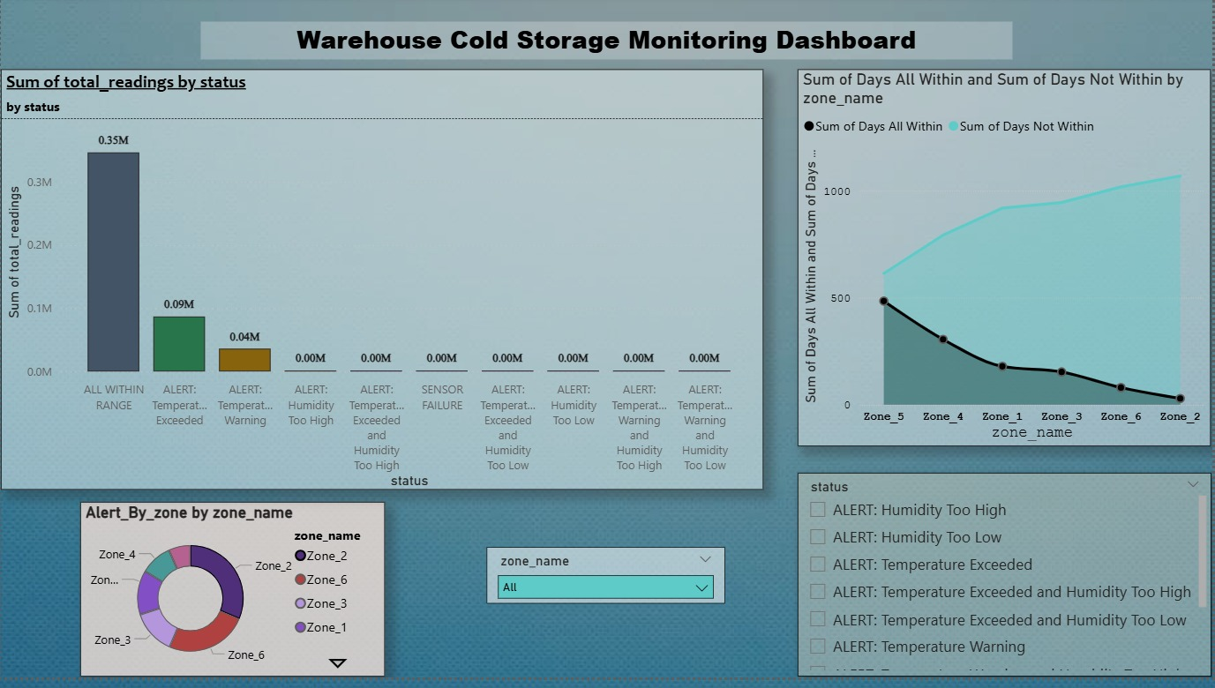
Power BI Dashboard
A real-time overview of your cold storage environment, transforming raw data into actionable insights.
Live Status Cards
Status Distribution
Zone-wise Alert Counts
Operational Performance
https://github.com/Sneha-Bhattacharyya/Execution_App/blob/main/Warehouse%20coldstorage%20monitoring%20dashboard.pbix
Power BI Dashboard File Link:

Slide 15
Power BI Development Steps
Our Power BI dashboard development involves a streamlined process to transform raw sensor data into actionable insights, ensuring comprehensive monitoring and reporting:
01
02
Connect PostgreSQL (NeonDB) to Power BI
Transform Data (DAX measures for latest readings, alerts, uptime)
03
04
Build Visuals: Cards, Charts, Filters
Add Interactive Slicers (Zones & Time Ranges)
These steps ensure a robust, user-friendly, and highly effective dashboard for monitoring your cold storage environment.

Slide 16


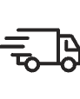
Key Takeaways & Future Vision
Our Intelligent IoT Cold Storage Monitoring Solution delivers tangible benefits, ensuring optimal conditions and operational efficiency:
Automated Monitoring
Enhanced Compliance
Actionable Alerts
Future Upgrades
Predictive Maintenance with ML: Leveraging machine learning to anticipate equipment failures before they occur.
Cloud IoT Scaling: Enhancing infrastructure to support larger deployments and increased data volumes.

Slide 17




Alternative Suggestions
While our current solution is robust, we are constantly exploring enhancements to push the boundaries of cold storage monitoring. Here are some alternative considerations for even more advanced capabilities:
Edge Devices for Offline Fallback
AI/ML Anomaly Detection
Full Cloud Integration
These advancements offer pathways to even greater system resilience, predictive power, and seamless integration within larger enterprise infrastructures.

Slide 18


